Slide 1
Python Refresher for AI

Slide 2
Introduction to Python:
Fundamentals and Setup

Slide 3
You have joined a startup tech company as a junior developer. Your team has been using multiple tools and programming languages for AI development, but your manager is considering transitioning to a more efficient and scalable option. The goal is to streamline data handling, automate repetitive AI-related tasks, and enhance overall productivity. As you explore different options, you come across Python, a widely used language in AI, data science, and automation.
Why do you think Python is commonly chosen for AI and machine learning tasks in tech companies? What challenges do you think Python can help you solve when working on AI projects?
Notes:
Mode: Sync
Estimated duration: 10 mins
Type: Instructor-led whole group discussion
Instructor notes:
Facilitate a whole group discussion to kick off today’s lesson. Ensure that you do not spend much time discussing the answers. This slide aims to gain the learners’ attention and relate the lesson theme with relatable examples before starting with the actual lecture topic.
Instructor script: [Notes of the LD: Provide a detailed script to guide the instructor in facilitating the discussion.]
The objective of the Question:
This discussion introduces learners to the significance of Python in AI, helping them reflect on the advantages that make Python the go-to language in this field.
Expected Learner Responses:
Python has simpler syntax, making it easier to write and understand AI models.
Python supports powerful AI and ML libraries like TensorFlow, PyTorch, and Scikit-learn.
Python’s large community provides extensive support and resources for AI projects.
The language is highly flexible, allowing for quick prototyping and experimentation.
Python’s cross-platform compatibility makes it easy to deploy AI solutions.
Challenges that Python can solve: Automation of Repetitive Tasks – Python allows automation of data preprocessing, feature engineering, and model evaluation, reducing manual effort.
Complex Data Processing – Python's libraries like NumPy, Pandas, and Dask enable efficient handling, transformation, and analysis of large datasets.
Machine Learning and Deep Learning – With frameworks such as TensorFlow, PyTorch, and Scikit-learn, Python simplifies building, training, and deploying AI models.
Key Discussion Points for the Instructor:
Readability and simplicity: Python’s minimal syntax allows AI developers to focus on logic rather than complex coding structures.
Extensive libraries and frameworks: Python offers pre-built AI tools, reducing the time needed for development.
Strong industry adoption: AI research, startups, and major tech companies rely on Python.
Integration capabilities: Python easily integrates with other languages, cloud services, and data science tools.
Instructor’s Transition to the Lesson:
Now that we’ve discussed what makes a language easy to learn, let’s explore how Python meets these criteria.

Slide 4
Compare and classify different types of programming languages, program flow, and key programming principles to build a strong foundation for programming
Demonstrate how to install and configure the Python programming environment in an IDE to write and execute code effectively
Explain Python’s benefits and its role in AI and data science to recognize its impact on modern technology
Demonstrate the correct use of Python identifiers, indentation, and comments to write clean, structured, and readable code
Construct and manipulate different Python data types to effectively store and manage data and apply various operators to perform computations and make logical decisions in Python programs
Notes:
Mode: Sync
Estimated duration: 2 minutes
Type: Instructor-led
Instructor notes:
State the learning objectives of the lesson.

Slide 5
Programming Foundations
Notes:
Instructor notes:

Slide 6

What Is Programming?
It is the process of writing instructions for a computer to perform specific tasks. It involves designing, coding, and testing to solve real-world problems.
Uses
Develops applications, websites, and AI systems
Automates repetitive tasks
Examples
Web applications (Amazon, Netflix)
AI-powered chatbots (ChatGPT, Siri)
Notes:
Instructor notes:
Programming is how we communicate with computers to perform specific tasks. It involves designing, coding, and testing solutions to real-world problems. Think of programming as giving step-by-step instructions to a computer, just like writing a recipe for cooking.

Slide 7
Categories of Programming Languages
They are broadly classified into interpreted and compiled languages based on their method of execution.
Interpreted languages
Compiled languages
Code is executed line by line at runtime.
They run slower because it’s translated while running.
Errors are found while running, making debugging easier.
Examples: Python, JavaScript, Ruby
Code is converted into machine language before running.
They run faster because it’s already translated.
Errors are found after compilation, making debugging harder.
Examples: C, C++, Java
Notes:
Instructor notes:
Programming languages can be broadly classified into interpreted and compiled languages based on how they are executed. The difference lies in how the code is processed before it runs on a computer.
Performance vs. Flexibility: Compiled languages run faster, but interpreted languages offer more flexibility for rapid development.

Slide 8
Types of Programming Languages
Procedural languages
Object-oriented languages
Based on step-by-step instructions
Examples: C, Pascal
Based on classes and objects
Examples: Java, Python
Functional languages
Scripting languages
Based on mathematical functions
Examples: Haskell, Scala
Used for automation and web development
Example: JavaScript, Python
Notes:
Instructor notes:
This slide introduces the four main types of programming languages, each serving different purposes. Procedural Languages - best suited for applications with a clear sequence of operations, such as banking systems.
Object-Oriented Languages - widely used in modern application development, such as game engines and enterprise applications.
Functional Languages - highly effective in handling big data processing due to its ability to handle parallel execution.
Scripting Languages - frequently used in DevOps for automation, such as writing shell scripts for server management.

Slide 9
Understanding Program Flow
It describes how a computer processes instructions in a logical sequence to produce the desired outcome. The basic flow of a program is as follows:
Processing
The program validates and processes user input.
Example: Checking password validity
01
02
03
Input
Output
A user enters data.
Example: Typing in a login form
The program generates results.
Example: Receiving a successful login message
Notes:
Instructor notes:
Program flow represents the logical sequence in which instructions are executed in a program. It ensures that inputs are processed correctly to generate meaningful outputs.
Understanding program flow helps in designing efficient algorithms. Every program follows a structured input → processing → output model.

Slide 10

Key Programming Principles
The following programming principles ensure that code is efficient, readable, and maintainable:
Avoid repetition
Focus on debugging
Using functions and loops to avoid redundant code
Anticipate and handle errors in your code
Improve readability
Keep it simple
Write clean, simple, and understandable code
Use meaningful variable
names, comments, and
proper indentation
Ensure modularity
Divide a program into functions
for better organization
Notes:
Instructor notes:
Writing efficient and maintainable code is crucial for any programming project. Following fundamental principles ensures that code is structured, reusable, and easy to debug. These principles help in improving software quality and reducing complexity.

Slide 11
How do interpreted languages handle execution?
They execute the entire code at once.
They convert code into machine language before execution.
They execute code line by line at runtime.
They do not require an interpreter to run.
Notes:
Mode: Sync
Estimated duration: 5 minutes
Type: Instructor-led poll question
Instructor notes:
Conduct the poll and identify areas of misunderstanding
Provide immediate feedback and clarify misconceptions
Reteach unclear concepts and proceed when learners demonstrate understanding
Correct Answer: C) They execute code line by line at runtime
Explanation: Interpreted languages process code line by line during execution rather than being compiled into machine code beforehand. This means that each line of code is translated and executed immediately, making debugging easier but often resulting in slower performance compared to compiled languages.

Slide 12
Introduction to Python
Notes:
Instructor notes:

Slide 13
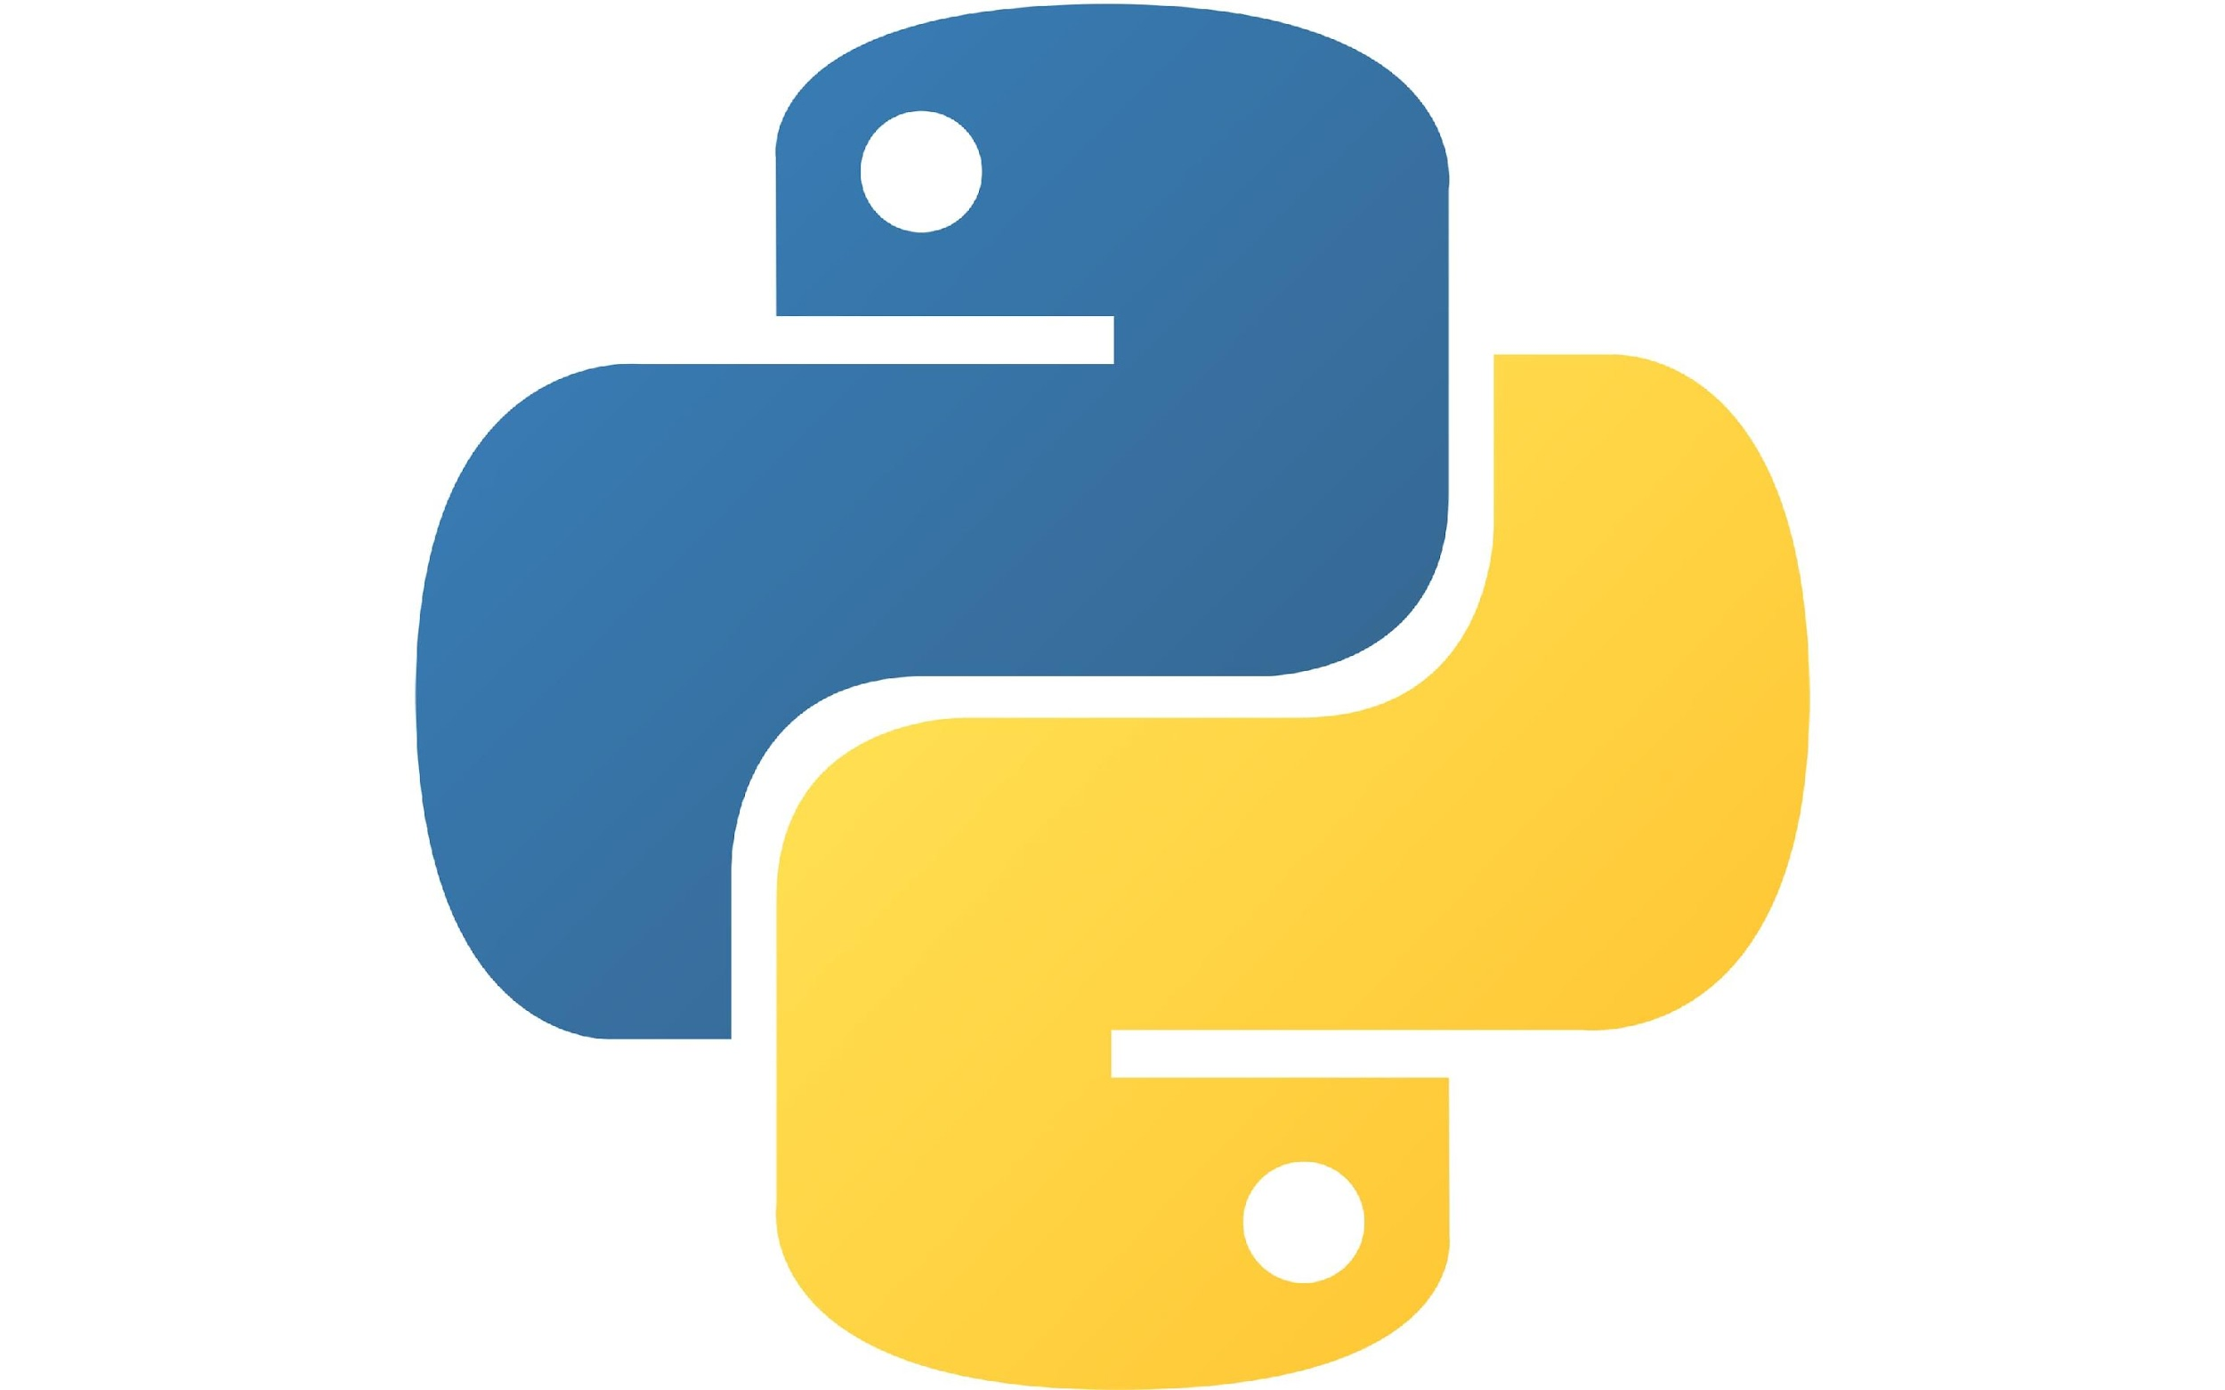
What Is Python?
It is a high-level, interpreter-based, object-oriented programming language with dynamic semantics used for various applications, such as data science and automation.
Python's simple and easy-to-learn syntax emphasizes readability and reduces the cost of program maintenance. It also supports modules and packages, encouraging program modularity and code reuse.
Notes:
Instructor notes:
Python is a high-level, interpreted, and object-oriented programming language known for its readability, simplicity, and versatility. It is widely used across different fields, from web development to AI and automation.
It is a simple, general-purpose programming language.
It is also a free and open-source language.

Slide 14
Python: History
It was conceived in the late 1980s.
It was invented
by Guido van Rossum
(Centrum Wiskunde and Informatica, Amsterdam).
It is named after the BBC comedy series Monty Python’s
Flying Circus.
It is now maintained by the Python Software Foundation (PSF).
It is derived from the ABC, Modula-3, Lisp, and C languages.
Notes:
Instructor notes:
Python was created in the late 1980s by Guido van Rossum at the Centrum Wiskunde & Informatica (CWI) in the Netherlands. It was developed as a successor to the ABC programming language, aiming to improve its limitations while keeping its simplicity.

Slide 15
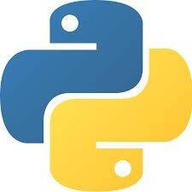
Benefits of Python
Flexible
It aids in the cross-platform compatibility and scripting of web pages and applications.
Easy to learn and use
It uses a minimal amount of code to complete tasks.
Readability
It places a strong emphasis on readable code and permits the use of English keywords in place of punctuation.
Robust standard library
It allows selecting a module from a large selection based on the requirement.
Notes:
Instructor notes:
Self-explanatory
Additional Points:
Python supports both object-oriented and functional programming paradigms.
It is widely used in AI, data science, web development, and cybersecurity.
Its active community ensures continuous updates and extensive documentation, making problem-solving easier.

Slide 16
Why Python for AI?
Python has become the dominant language for artificial intelligence (AI) and machine learning (ML)
due to its:
Powerful AI libraries and frameworks
Seamless data handling and visualization
High-level syntax and rapid prototyping
Strong industry adoption and community support
Integration with other technologies
Example:
Companies like Netflix and Spotify use Python-based AI models to recommend personalized content, enhancing user experience through predictive analytics.
Notes:
Instructor notes:
Powerful AI Libraries & Frameworks Python offers pre-built libraries, such as TensorFlow, PyTorch, Scikit-Learn, and Keras, that simplify AI and ML model development.
Seamless Data Handling & Visualization Libraries like Pandas, NumPy, and Matplotlib allow efficient data manipulation and visualization, making Python ideal for AI-driven insights.
High-Level Syntax & Rapid Prototyping Python’s simple syntax allows faster model development, making it easy for AI researchers and engineers to test ideas quickly.
Strong Industry Adoption & Community Support Tech giants like Google, Meta, and OpenAI use Python for AI, ensuring continued growth and strong developer support.
Integration with Other Technologies Python integrates easily with Big Data tools, Cloud computing, and IoT systems, making it a flexible choice for AI-driven applications.

Slide 17
How AI Is Changing Coding
The rise of AI in software development has transformed how developers write, debug, and optimize code. The following are key areas where AI is reshaping the coding landscape:
Code generation
Bug detection and debugging
Low-code and
no-code platforms
Predictive coding and smart suggestions
Notes:
Instructor notes:
AI-Powered Code Generation: AI tools like GitHub Copilot and Tabnine can generate entire blocks of code, reducing the need for manual coding. This speeds up development and improves efficiency.
AI for Bug Detection and Debugging: AI-driven debugging tools analyze code in real-time to identify potential errors, suggest fixes, and optimize performance. These tools help developers detect syntax errors, logical bugs, and vulnerabilities.
Low-Code and No-Code Platforms: AI enables drag-and-drop coding solutions that allow non-programmers to build applications. Platforms like Bubble and OutSystems make software development more accessible.
Predictive Coding and Smart Suggestions: AI predicts the next best lines of code, helping developers write code faster and with fewer errors. It suggests variable names, function calls, and logical structures, making code more intuitive.

Slide 18
What role does Python play in AI-driven recommendation systems like Netflix and Spotify?
It automates video playback
It helps train machine learning models for personalized content recommendations
It is used for user authentication
It improves internet speed for better streaming
Notes:
Mode: Sync
Estimated duration: 5 minutes
Type: Instructor-led poll question
Instructor notes:
Conduct the poll and identify areas of misunderstanding
Provide immediate feedback and clarify misconceptions
Reteach unclear concepts and proceed when learners demonstrate understanding
Correct Answer: B) It helps train machine learning models for personalized content recommendations
Explanation: Python is widely used in AI-driven recommendation systems because of its powerful machine learning (ML) and data processing libraries like Scikit-Learn, TensorFlow, and PyTorch. Companies like Netflix and Spotify use Python-based ML models to analyze user behavior, track preferences, and provide personalized movies, shows, and music recommendations.

Slide 19
Exploring Python Development Environments
Notes:
Instructor notes:

Slide 20
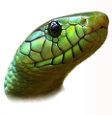









Python IDE
An integrated development environment (IDE) is a software suite that consolidates the basic tools required to write and test software. A Python program can run on the following IDEs:
Eric
Wing
Atom
PyDev
PyCharm
Jupyter Notebook
Rodeo
Thonny
Spyder
Microsoft VS Code
Notes:
Instructor notes:
IDEs enhance productivity by combining multiple functionalities like code editing, debugging, and execution in a single interface.
Eric – A lightweight and powerful IDE designed for Python, featuring integrated debugging and project management tools.
Wing – Provides intelligent code suggestions, debugging, and testing features tailored for Python developers.
Atom – A hackable text editor with strong Python support through extensions and customization.
PyDev – An Eclipse-based IDE that integrates with Java, making it suitable for mixed-language development.
PyCharm – One of the most popular Python IDEs, offering advanced code completion, debugging, and seamless integration with frameworks.
Jupyter Notebook – An interactive web-based IDE for data science and machine learning, supporting live code execution and visualization.
Rodeo – Best suited for data science and analytics, featuring built-in support for plotting and visualization.
Thonny – A beginner-friendly IDE with an intuitive interface, making it ideal for learning Python.
Spyder – A scientific computing IDE that integrates with libraries like NumPy, SciPy, and Matplotlib.
Microsoft VS Code – A versatile, lightweight code editor with Python extensions for debugging, linting, and version control.

Slide 21

Recommended Python Development Environments
Some commonly used and recommended Python workspaces are:
Visual Studio Code
Jupyter Notebook
Google Colab
Notes:
Instructor notes: VS Code - A lightweight yet powerful source code editor that supports multiple languages, including Python, through extensions
Jupyter Notebook - An open-source web-based interactive computing environment mainly used for data science, AI, and ML
Google Colab - A cloud-based Jupyter Notebook environment provided by Google, eliminating the need for local setup

Slide 22
Visual Studio Code: Features
Python extension
Multi-language support
Built-in terminal
AI-powered assistance
Live collaboration
Notes:
Instructor notes:
Multi-language support: Works with Python, JavaScript, Java, C++, and more.
Python extension: Enables linting, debugging, and IntelliSense for Python.
Built-in terminal: Executes Python scripts without switching applications.
Live collaboration: Users can collaborate remotely via Live Share.
AI-powered assistance: GitHub Copilot helps with code suggestions.

Slide 23
Installing and Setting Up VS Code
10
Overview: This demonstration covers installing and setting up VS Code for Python development. You will learn how to download the installer, configure essential settings, and launch VS Code without any errors.
Note:
Please download the demo document from the Reference Material section for step-by-step guidance.
Notes:
Mode: Sync
Estimated duration: 15 to 20 mins
Type: Instructor-led activity
Instructor notes:
Demonstrate the tasks step-by-step.
Encourage learners to follow along with you.
Mention that participation is optional. They can try the steps later using the demo document and recorded sessions.
Inform learners that the demo document is available for download in the LMS under “Resources.”

Slide 24
Jupyter Notebook: Features
Interactive code execution
Integration with data science libraries
Cloud and local execution
Notebook sharing and exporting
Extensibility with plugins
Notes:
Instructor notes:
Interactive code execution - Run code in small sections (cells) and see instant outputs, making debugging and iteration easier.
Integration with data science libraries - Seamlessly use libraries like Pandas, NumPy, Matplotlib, and TensorFlow for data analysis and AI.
Notebook sharing and exporting - Convert notebooks into different formats such as HTML, PDF, or slides for easy sharing.
Extensibility with plugins - Customize and enhance Jupyter with various plugins, extensions, and widgets.
Cloud and local execution - Run Jupyter Notebooks locally or on cloud-based platforms like Google Colab for collaborative work.

Slide 25
Installing Jupyter Notebook Using Anaconda
10
Overview: This demonstration covers installing Jupyter Notebook using the Anaconda distribution for a seamless Python development environment. You will learn how to install Anaconda to launch Jupyter Notebook.
Note:
Please download the demo document from the Reference Material section for step-by-step guidance.
Notes:
Mode: Sync
Estimated duration: 15 to 20 mins
Type: Instructor-led activity
Instructor notes:
Demonstrate the tasks step-by-step.
Encourage learners to follow along with you.
Mention that participation is optional. They can try the steps later using the demo document and recorded sessions.
Inform learners that the demo document is available for download in the LMS under “Resources.”

Slide 26
Google Colab: Features
Free access to GPUs and TPUs
Google Drive integration
Cloud-based execution
Pre-installed libraries
Real-time collaboration
Notes:
Instructor notes:
Free access to GPUs and TPUs – hardware accelerators that can be used to significantly speed up machine learning tasks, particularly deep learning model training.
Google Drive integration – Save, access, and load files effortlessly from Google Drive.
Pre-installed libraries – Includes essential Python libraries like TensorFlow, NumPy, and Pandas for data science and AI.
Real-time collaboration – Share notebooks and work simultaneously with others, similar to Google Docs.
Cloud-based execution – Run Python code directly in the cloud without local installation.

Slide 27
Setting Up a Google Colab Notebook
10
Overview: This demonstration covers setting up a Google Colab notebook for writing and executing Python code in a cloud-based environment. You will learn how to create a new notebook in Google Colab and start coding without requiring any local installation.
Note:
Please download the demo document from the Reference Material section for step-by-step guidance.
Notes:
Mode: Sync
Estimated duration: 15 to 20 mins
Type: Instructor-led activity
Instructor notes:
Demonstrate the tasks step-by-step.
Encourage learners to follow along with you.
Mention that participation is optional. They can try the steps later using the demo document and recorded sessions.
Inform learners that the demo document is available for download in the LMS under “Resources.”

Slide 28
Which of the following IDEs is specifically designed for scientific computing and includes an interactive environment for data analysis?
PyCharm
Jupyter Notebook
VS Code
Atom
Notes:
Mode: Sync
Estimated duration: 5 minutes
Type: Instructor-led poll question
Instructor notes:
Conduct the poll and identify areas of misunderstanding
Provide immediate feedback and clarify misconceptions
Reteach unclear concepts and proceed when learners demonstrate understanding
Correct Answer: B) Jupyter Notebook
Explanation: Jupyter Notebook is specifically designed for scientific computing, data analysis, and interactive programming. It allows users to write and execute Python code in a web-based interface, making it ideal for data visualization, machine learning, and research applications.

Slide 29
Python Syntax: Structure and Execution
Notes:
Instructor notes:

Slide 30




Python Syntax
It refers to a set of rules that define how code should be written and structured so that the Python interpreter can understand and execute it correctly.
Some basic Python syntaxes are:
Identifier
Indentation
Comments
Input and output
Notes:
Instructor notes:
Proper syntax ensures error-free execution, improves readability, and maintains best coding practices, making Python an efficient language for both beginners and professionals.
Python Identifiers: Identifiers are variable, function, and class names.
Python Indentation: Unlike other languages, Python relies on indentation (whitespace) to define blocks of code.
Python Comments: Comments in Python help explain code and are ignored during execution.
Python User Input and Output: Python uses the input() function to take user input. The input is always stored as a string unless explicitly converted to another data type. The output can be displayed in Python using the print() function.

Slide 31

Python: Identifier
It is a name used to identify a variable, function, class, module, or another object.
The following are a few identifier naming rules:
Identifiers can be a combination of:
Letters in lowercase (a to z) or uppercase (A to Z)
Digits (0-9)
Underscore ( _ )
Special symbols like !, @, #, $, and % cannot be used in an identifier.
An identifier can be of any length,
but cannot start with a digit.
Keywords like global and class cannot be used as identifiers.
Python is case-sensitive, so a is not equal to A.
Notes:
Instructor notes:
Identifiers in Python are names given to variables, functions, classes, and modules. They help in referring to program elements efficiently.
Valid Identifiers: Identifiers can contain letters (a-z, A-Z), digits (0-9), and underscores (_) but cannot start with a digit. They can be of any length, ensuring flexibility in naming conventions.

Slide 32
Python: Identifier
Here are a few examples of identifiers:
Valid identifiers:
myClass,
var_1,
count
Invalid identifiers:
1variable,
class@new,
global
Notes:
Instructor notes:
-> Identifiers must begin with a letter or underscore but cannot start with a digit.
-> Special characters like @, #, $, and % are not allowed in variable names.
-> Python reserved words (like class, def, global) cannot be used as identifiers.
-> Following consistent naming conventions (CamelCase, snake_case) improves code readability.

Slide 33
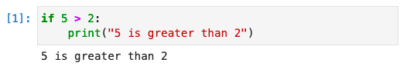
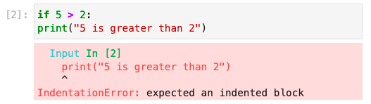
Python: Indentation
It refers to the space at the beginning of a code line.
Correct syntax
An indented block of code begins with a colon (:).
Python's indentation is crucial as it makes code easier to understand, unlike other programming languages.
Python uses indentation to indicate a block of code. For example, indentation is required for conditional statements and loops such as if … else, for loop, and while loop, or else an error will occur.
Incorrect syntax
Notes:
Instructor notes: Unlike many other programming languages that use braces {} or keywords to define code blocks, Python strictly uses indentation (spaces or tabs) to define blocks of code.

Slide 34
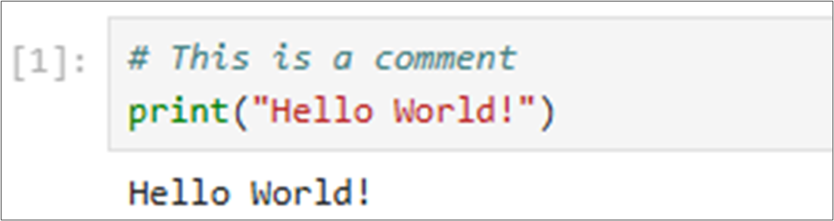
Python: Comments
They are annotations or programmer-readable explanations in a computer program's source code that make it easier for humans to understand the code.
Example:
A comment in Python starts with #, and the rest of the line is considered a comment.
Notes:
Instructor notes:
Comments in Python are annotations within the code that help programmers understand what the code does. They are ignored by the interpreter and have no effect on the program’s execution.

Slide 35

Python: Input and Output
Python provides simple yet powerful functions to handle user input and output display.
The two primary functions used for this are:
input()
print()
The input() function allows users to enter data during program execution.
The print() function displays the output on the screen.
name = input(“Enter your name:”) print(“Hello,”, name)
Print(“Welcome to Python!”)
Notes:
Instructor notes:
Python provides two fundamental functions for handling user interaction:
input() - It allows users to enter data during program execution.
print() - Used to display messages, variables, and results.

Slide 36
Which of the following identifier names follows Python’s rules and best practices for readability?
_var123
_321CustomerDetailsDBTable
1st_name
final_result_value
Notes:
Mode: Sync
Estimated duration: 5 minutes
Type: Instructor-led poll question
Instructor notes:
Conduct the poll and identify areas of misunderstanding
Provide immediate feedback and clarify misconceptions
Reteach unclear concepts and proceed when learners demonstrate understanding
Correct Answer: D) final_result_value
Explanation:
_var123 is valid but not recommended unless for internal/private variables.
CustomerDetailsDBTable is valid but violates Python’s PEP-8 naming convention (should use snake_case).
1st_name is invalid because an identifier cannot start with a number.
final_result_value follows Python’s naming convention for variables using snake_case.

Slide 37
Writing and Running a Python Program
10
Overview: This demonstration covers writing and running a Python program while exploring its basic syntax, indentation rules, and comments. You will learn how to incorporate user input and the print() function to create an interactive script.
Note:
Please download the demo document from the Reference Material section for step-by-step guidance.
Notes:
Mode: Sync
Estimated duration: 15 to 20 mins
Type: Instructor-led activity
Instructor notes:
Demonstrate the tasks step-by-step.
Encourage learners to follow along with you.
Mention that participation is optional. They can try the steps later using the demo document and recorded sessions.
Inform learners that the demo document is available for download in the LMS under “Resources.”

Slide 38
Python Variables and Data Types
Notes:
Instructor notes:

Slide 39
Python Variables: A Fundamental Building Block
Variables in Python are used to store data values, making it easier to manipulate
and manage data in a program.
The following are examples of variables:
x = 10 # Integer variable
name = "Alice" # String variable
price = 99.99 # Float variable
is_active = True # Boolean variable
# Assigning multiple variables in a single line
a, b, c = 1, "Hello", 3.14
Notes:
Instructor notes: Variables in Python are used to store data values, making it easier to manage and manipulate data within a program.
Note: Unlike other languages, Python does not require explicit declaration of data types. The type is assigned based on the value.

Slide 40
Data Types
Variables can store various kinds of data, and each kind has a specific function.
Scalar data
Integer: 2323, 10
Float: 32.3, 31.2e5
Boolean: True , False
Complex: 2 + 6j
Aggregated data
String: “abc” , ‘xyz’
Set: {2, 4, 6, ‘abc’}
List: [23, 9.8, ‘a’, ‘b’, ‘a’]
Tuple: (34.5, ‘a’ , 45, ‘w’)
Dictionary: {‘a’ : 1 , ‘b’ : 3}
Types of data
Note
The data type of any object can be checked using the built-in function type().
Notes:
Instructor notes: In Python, variables can store different types of data. Each data type has a specific function and determines how the data can be manipulated. Understanding data types is fundamental to writing efficient and error-free Python programs.

Slide 41
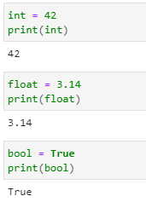
Scalar Data
This type represents a single value. The syntax and examples of scalar data are as follows:
Integer represents whole numbers without a fractional part.
Float represents real numbers with a fractional part.
Boolean represents two values, either True or False.
Notes:
Instructor notes: Scalar data types represent single values and are fundamental in Python programming. These types include integers, floating-point numbers, and Boolean values. Understanding scalar data is crucial for working with numbers, conditions, and mathematical computations in Python.

Slide 42
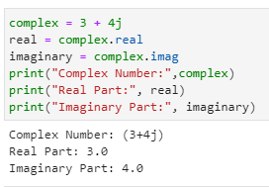
Scalar Data
This type represents a single value. The syntax and examples of scalar data are as follows:
The complex data type in Python represents complex numbers.
Complex numbers are expressed as a + bj, where a is the real part, and b is the imaginary part.
Notes:
Instructor notes: Scalar data types represent single values and are fundamental in Python programming. These types include integers, floating-point numbers, and Boolean values. Understanding scalar data is crucial for working with numbers, conditions, and mathematical computations in Python.

Slide 43
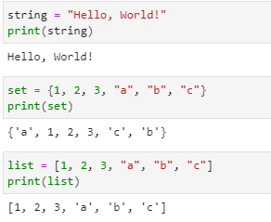
Aggregated Data
This type represents collections of values. The syntax and examples of aggregated data are as follows:
String represents sequences of characters enclosed in single, double, or triple quotes.
Set is an unordered collection of unique items in Python.
List is an ordered collection of items, which are mutable.
Notes:
Instructor notes:
Aggregated data types in Python store collections of values, allowing for flexible data manipulation and organization. These types include strings, sets, and lists.
Understanding these data types is essential for working with structured data, managing collections, and performing efficient operations in Python.

Slide 44
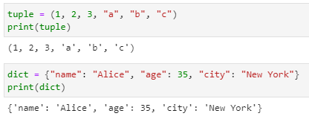
Aggregated Data
This type represents collections of values. The syntax and examples of aggregated data are as follows:
Tuple is an ordered collection of items that are immutable.
Dictionaries are an unordered collection of key-value pairs.
Notes:
Instructor notes:
Aggregated data types in Python store collections of values, allowing for flexible data manipulation and organization. These types include strings, sets, and lists.
Understanding these data types is essential for working with structured data, managing collections, and performing efficient operations in Python.

Slide 45
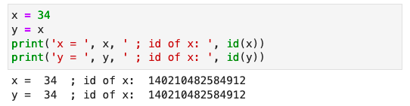
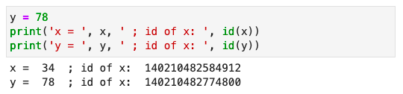
Data Assignment
Python variables are references to objects, but the actual data is contained in the objects.
Here, x and y point to the same memory location where 34 (an integer object) is stored.
Here, y points to a new integer object with 78 as a value, and x points to the previous object with a value of 34.
These references can be verified using the id() function.
Notes:
Instructor notes: Python variables are references to objects, but the actual data is stored in the objects. Variables act as pointers to these objects rather than holding the data directly.
Understanding Python’s memory model is crucial for optimizing memory usage and debugging variable assignments in complex programs.

Slide 46
What is the default data type of a variable assigned using the input() function in Python?
int
float
str
list
Notes:
Mode: Sync
Estimated duration: 5 minutes
Type: Instructor-led poll question
Instructor notes:
Conduct the poll and identify areas of misunderstanding
Provide immediate feedback and clarify misconceptions
Reteach unclear concepts and proceed when learners demonstrate understanding
Correct Answer: C) str
Explanation: The input() function always returns a string by default. If numerical input is required, explicit type conversion is needed, e.g., int(input()) or float(input()).

Slide 47
Storing User Information Using Different Data Types
10
Overview: This demonstration covers storing and processing user input in Python using different data types. You will learn how Python assigns values such as strings, integers, and floats to variables, processes them for display using the print() function, and manages user input efficiently.
Note:
Please download the demo document from the Reference Material section for step-by-step guidance.
Notes:
Mode: Sync
Estimated duration: 15 to 20 mins
Type: Instructor-led activity
Instructor notes:
Demonstrate the tasks step-by-step.
Encourage learners to follow along with you.
Mention that participation is optional. They can try the steps later using the demo document and recorded sessions.
Inform learners that the demo document is available for download in the LMS under “Resources.”

Slide 48
Python Operators
Notes:
Instructor notes:

Slide 49
Operators
In Python, operators are special symbols or keywords that perform computations.
Its purposes include:
Telling the interpreter to perform specific mathematical, relational, or logical operations to produce a result
Operating on operands, which are the values or variables on which the operation is performed
Notes:
Instructor notes: Operators are essential in Python programming as they allow for efficient manipulation of data. Understanding how and when to use each operator can significantly improve the effectiveness of code execution and logic implementation.

Slide 50
Types of Operators
Arithmetic
operators
Miscellaneous operator
Assignment operators
Logical
operators
Comparison operators
Notes:
Instructor notes: Python operators simplify mathematical, logical, and bitwise computations. Understanding each category is key to writing efficient and optimized Python code.
1. Arithmetic Operators
Used for mathematical computations.
2. Assignment Operators
Assign values to variables, with shorthand operations.
3. Comparison (Relational) Operators
Used to compare values, returning True or False.
4. Logical Operators
Used for Boolean logic operations.
5. Miscellaneous Operators
Identity Operators (is, is not):
Used to check if two objects reference the same memory location.
Membership Operators (in, not in):
Used to check for membership in sequences like lists, tuples, and strings.

Slide 51
Arithmetic Operators
Different arithmetic operators are given below with examples:
Operator | Description | Example
+ | Addition | >> x = 12 ; y = 50 >> x + y 62
- | Subtraction | >> x = 45 ; y = 24 >> x - y 21
* | Multiplication | >> x = 50 ; y = 4 >> x * y 200
/ | Division | >> x = 50 ; y = 4 >> x / y 12.5
Notes:
Instructor notes: Arithmetic operators are symbols used to perform basic mathematical operations like addition, subtraction, multiplication, and division.

Slide 52
Arithmetic Operators
Different arithmetic operators are given below with examples:
Operator | Description | Example
% | Modulo | >> x = 50 ; y = 4 >> x % y 2
// | Integer divide | >> x = 50 ; y = 4 >> x // y 12
** | Exponent | >> x = 5 ; y = 4 >> x ** y 625
Notes:
Instructor notes:
This slide is self explanatory.

Slide 53
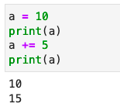
Assignment Operators
The equal to (=) operator is used for data assignment in Python.
Example:
Assignment operators can be combined with arithmetic operators.
Here, a += 5 is the same as a = a + 5.
Similar operators are: -= , *=, /=, %=, //=, and **=
Notes:
Instructor notes:
The assignment operator allows you to store data in variables, making them accessible for further use in your code.

Slide 54
Comparison Operators
They are used to compare two values.
Operator | Description | Example
== | Returns True when the two values are equal | >> x = 20 ; y = 20 >> x == y True
!= | Returns True when the two values are not equal | >> x = 45 ; y = 24 >> x != y True
Note
These operators return true or false based on the comparison.
Notes:
Instructor notes:
Comparison operators in Python are used to compare two values and evaluate their relationship. These operators return a Boolean value (True or False) based on the result of the comparison.

Slide 55
Comparison Operators
They are used to compare two values.
Operator | Description | Example
< | Returns True when the first value is less than the second | >> x = 20 ; y = 30 >> x < y True
> | Returns True when the first value is greater than the second | >> x = 40 ; y = 30 >> x > y True
Note
These operators return true or false based on the comparison.
Notes:
Instructor notes:
This slide is self explanatory.

Slide 56
Comparison Operators
They are used to compare two values.
Operator | Description | Example
<= | Returns True when the first value is less than or equal to the second value | >> x = 10 ; y = 30 >> x <= y True
>= | Returns True when the first value is greater than or equal to the second value | >> x = 30 ; y = 30 >> x >= y True
Note
These operators return true or false based on the comparison.
Notes:
Instructor notes:
This slide is self explanatory.

Slide 57
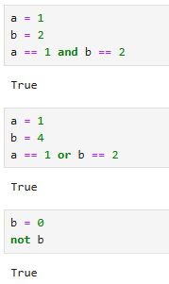
Logical Operators
They are used for combining conditional statements.
Operator | Description
and | Returns True if both statements are true
or | Returns True if one of the statements is true
not | Reverses the results, returns True if the result is false
Notes:
Instructor notes:
Logical operators in Python are used to combine and manipulate conditional statements. These operators allow you to create complex conditions by combining multiple individual conditions.

Slide 58
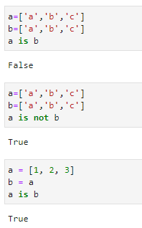
Miscellaneous Operators
They are used for more specific operations than arithmetic, logical, and comparison operators. There are two types of miscellaneous operators: identity and membership.
1. Identity operators
They compare variables to see whether they are the same object at the same memory address.
is: Returns True if both variables are the same object
is not: Returns True if both variables are not the same object
Notes:
Instructor notes:
Miscellaneous operators in Python include identity operators and membership operators. These operators are used for more specific operations compared to arithmetic, logical, and comparison operators.
1. Identity Operators:
- `is`: Checks if two operands refer to the same object.
- `is not`: Checks if two operands do not refer to the same object.

Slide 59
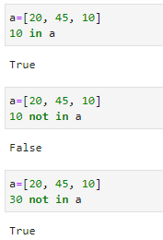
Miscellaneous Operators
2. Membership operators
They test if a sequence is present in an object.
in: Returns True if a value is present in the object
not in: Returns True if a value is not present in the object
Notes:
Instructor notes:
In Python, there are two kinds of miscellaneous operators:
2. Membership Operators:
- `in`: Checks if a value is present in a specified sequence or container.
- `not in`: Checks if a value is not present in a specified sequence or container.

Slide 60
What is the main difference between the == and is operators in Python?
== checks object identity, whereas is compares values
== compares values, whereas is checks object identity
Both == and is perform the same function
== is used for arithmetic operations, while is
is used for assignments
Notes:
Mode: Sync
Estimated duration: 5 minutes
Type: Instructor-led poll question
Instructor notes:
Conduct the poll and identify areas of misunderstanding
Provide immediate feedback and clarify misconceptions
Reteach unclear concepts and proceed when learners demonstrate understanding
Correct Answer: B) is checks object identity, whereas == compares values
Explanation: == checks if values are the same. is checks if both variables refer to the same memory location.

Slide 61
Comparing Numbers Using Python Operators
10
Overview: This demonstration covers applying Python’s comparison operators to evaluate relationships between numbers. You will learn how to take user input, implement comparison operations, and understand how conditions and comparisons support decision-making in Python programming.
Note:
Please download the demo document from the Reference Material section for step-by-step guidance.
Notes:
Mode: Sync
Estimated duration: 15 to 20 mins
Type: Instructor-led activity
Instructor notes:
Demonstrate the tasks step-by-step.
Encourage learners to follow along with you.
Mention that participation is optional. They can try the steps later using the demo document and recorded sessions.
Inform learners that the demo document is available for download in the LMS under “Resources.”

Slide 62
20
In this guided practice, you will take on the role of a software engineering intern at a fast-growing startup. Your first assignment is to develop a Comprehensive Employee Financial Insights System that collects and analyzes employee salary data. You will work hands-on with Python variables, data types, operators, indentation, and user input and output.
Notes:
Mode: Sync
Estimated duration: 20 to 30 mins
Type: Small-Group Activity/Individual activity
Instructor Note:
Instruct the learners to download the guided practice from the LMS present under the reference material and complete the exercise.
Facilitate the guided practice exercise.
Monitor breakout rooms. (in case of group work)
Outside of Bootcamps, this activity is an individual exercise, with the instructor assisting learners in completing it independently in the live class.

Slide 63
Python is an interpreted language with powerful features like complex data structures and reusable modules.
Multiple IDEs support Python development, including Jupyter Notebook, VS Code, Spyder, and PyCharm.
Simple syntax makes Python easy to read, write, and maintain.
Variables in Python store different data types, such as integers, floats, strings, booleans, lists, tuples, and dictionaries.
Operators enable computations, including arithmetic, assignment, comparison, logical, and miscellaneous operations.
Notes:
Mode: Sync
Estimated duration: 5 mins
Type: Instructor-led activity
Instructor notes:
Provide a summary of the key topics covered to reinforce understanding
Highlight how the lesson’s learning objectives were achieved

Slide 64
Notes:
Mode: Sync
Estimated duration: 5 to 10 mins
Type: Whole-Group Activity
Instructor notes:
Invite learners to ask questions to clarify doubts
Address misconceptions and reinforce key concepts
Wrap up by summarizing key takeaways and next steps

